Slide 1
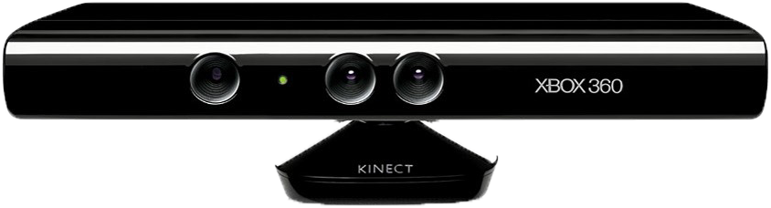
Motion sense gaming
-by Vineet Ahirkar

Slide 2
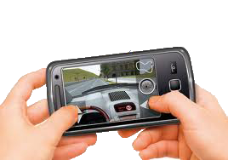
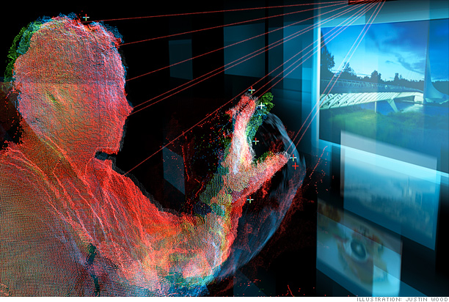
motion Sense technology
Infrared
Optics
Sound
Radio Frequency Energy

Slide 3
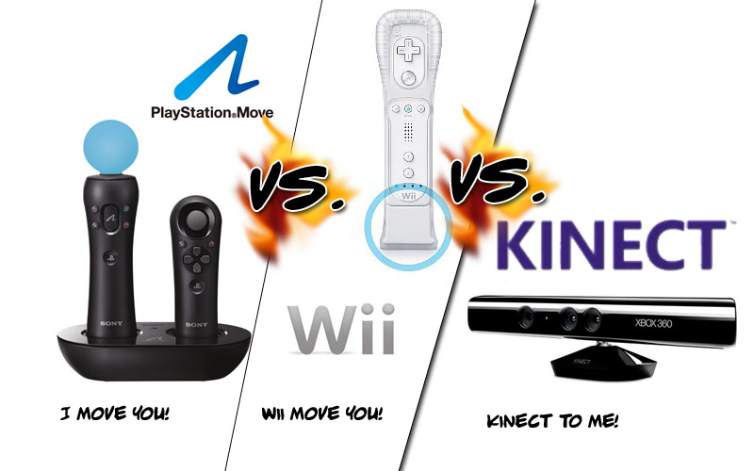
Be
Top gaming consoles in market today

Slide 4
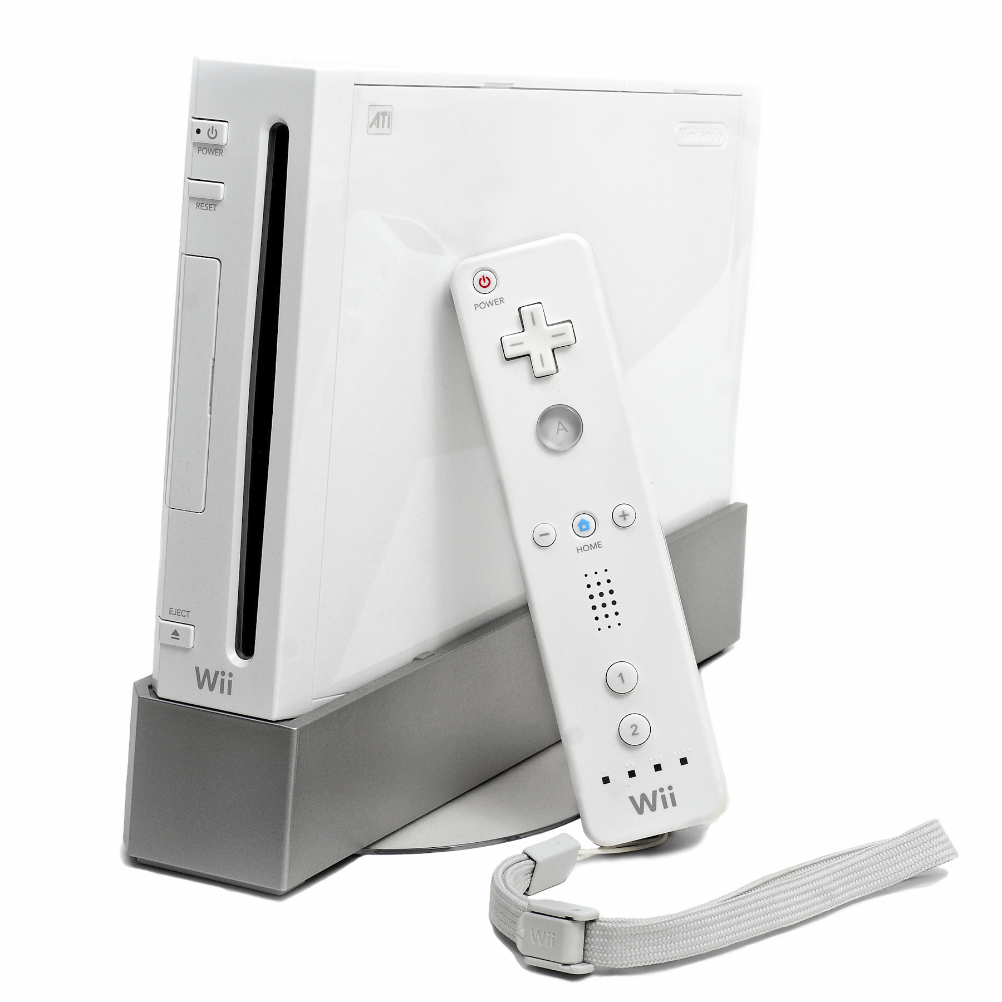
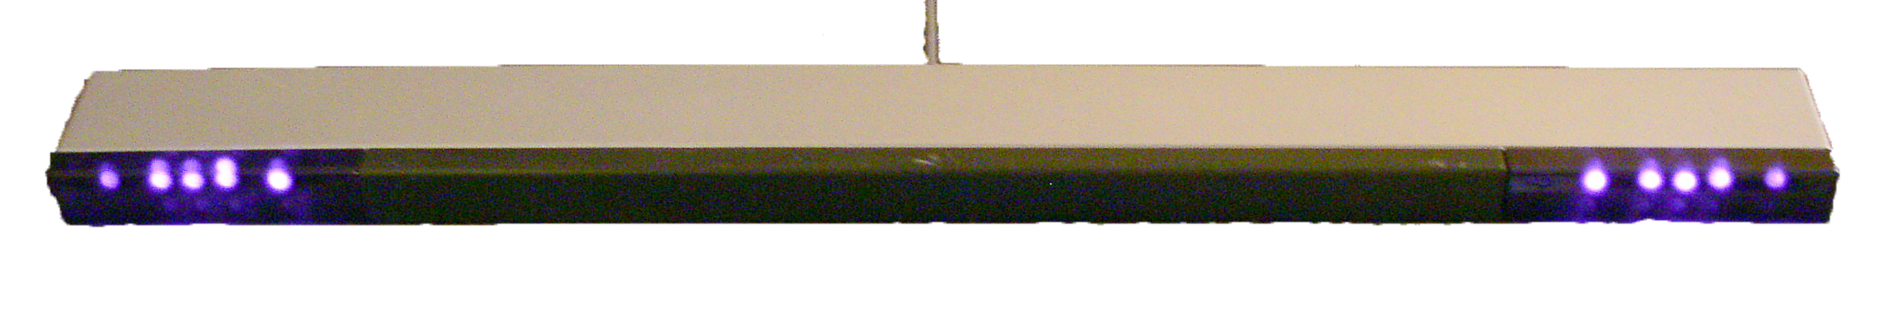
Wii console
Remote controller
Sensor Panel
WII
(Nov 2006)
Playstation Move
(Sept 2010)
Xbox Kinect
(Nov 2010)

Slide 5
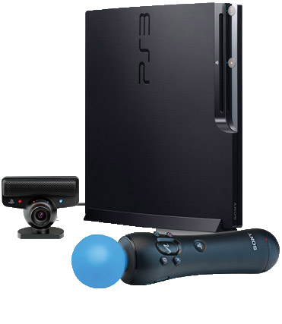
PS3 console
Play Stick
PS eye
WII
(Nov 2006)
Playstation Move
(Sept 2010)
Xbox Kinect
(Nov 2010)

Slide 6
Technology used
Accelerometer
-Linear acceleration
Gyroscope
-Angular movement
Magnetometer
-Controller's Orientation against the Earth's magnetic field
Direction of motion
Wii
IR camera
+
IR Sensor
PS3 Play
RGB camera
+
RGB LED-orb

Slide 7
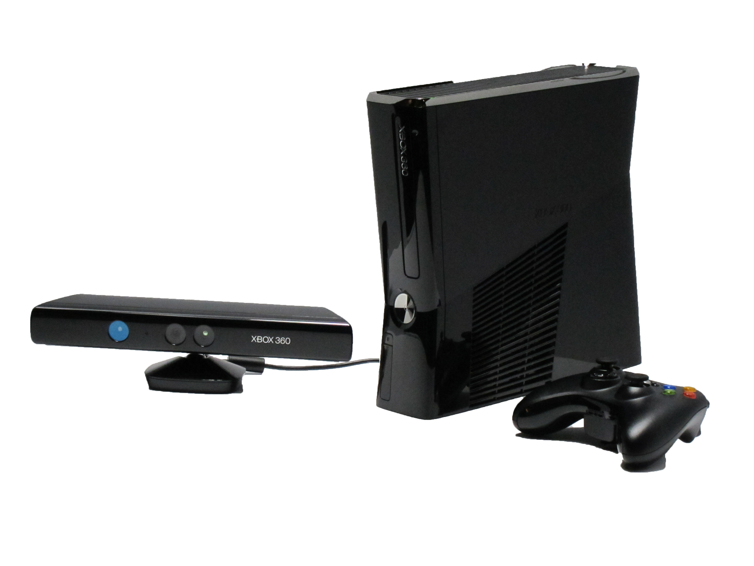
XBOX console
Controller
Kinect
WII
(Nov 2006)
Playstation Move
(Sept 2010)
Xbox Kinect
(Nov 2010)

Slide 8
Why Kinect…?
Full Body Gaming
Use Your Voice
Something For Everyone
It’s All About Your Avatar

Slide 9
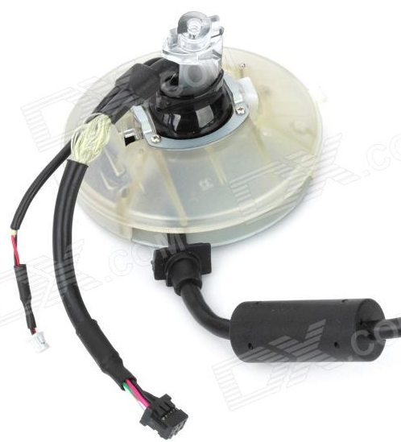
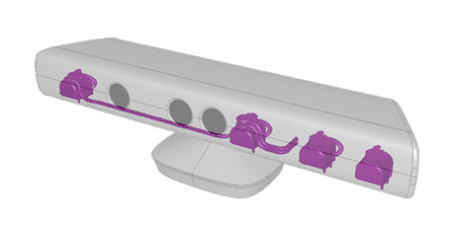
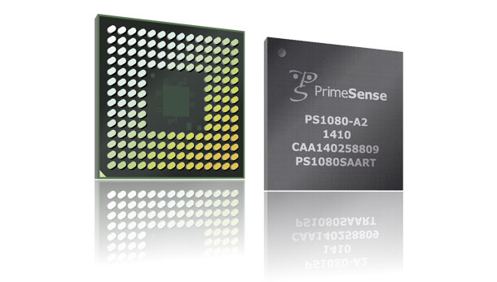
What’s inside ?
IR projector
PrimeSense processor
RGB camera
Microphone array
Motorized pivot
IR camera

Slide 10
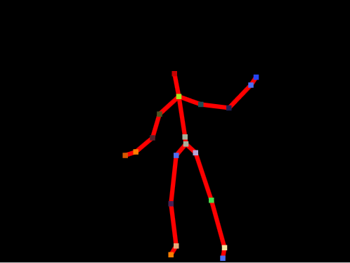
Basic process of motion sensing
1.Structured Light Analysis
2.Machine Learning
3.Body tracking

Slide 11
Structured Light Analysis
1.
B.
Depth from Focus
A.
Depth from Stereo

Slide 12
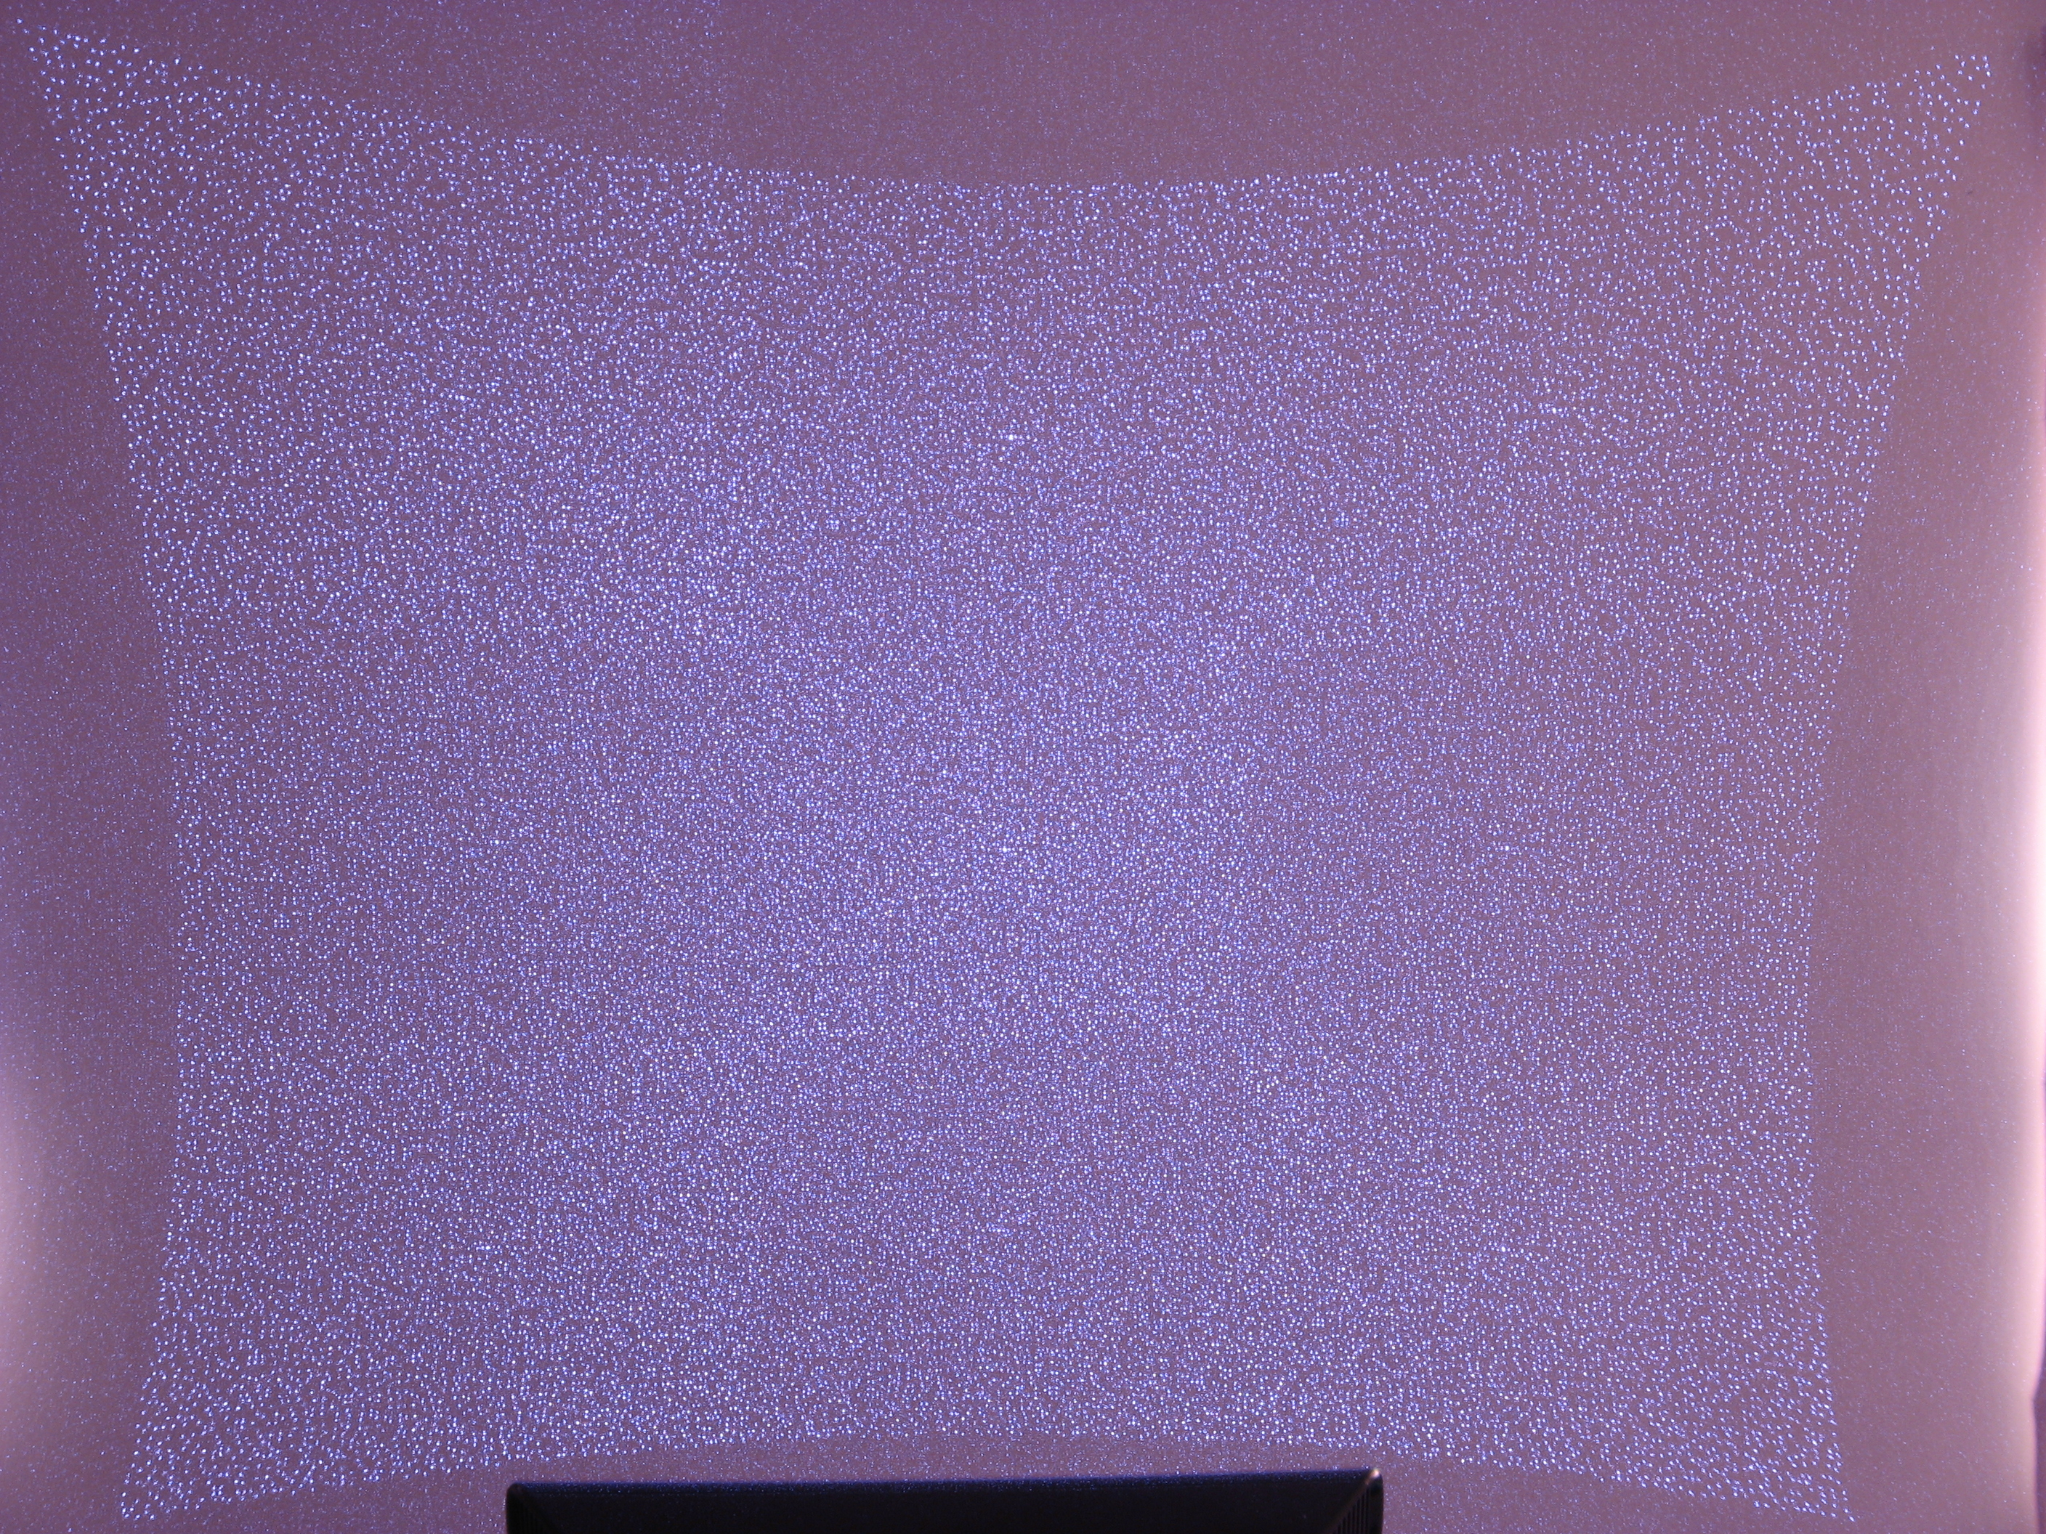
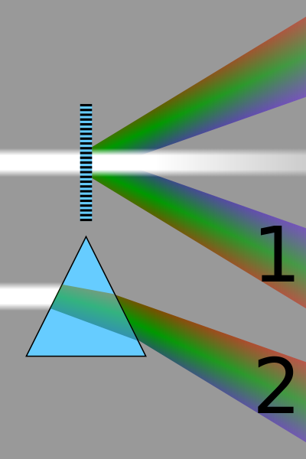
Speckle pattern
IR laser passed through Diffraction grating
Randomly generated speckles formed
Developed and Patented by Israeli company named PrimeSense
Known as Structured Light

Slide 13
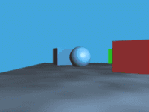
Depth from Stereo
Potential matches for x have to lie on the corresponding line l’.
Potential matches for x’ have to lie on the corresponding line l.

Slide 14
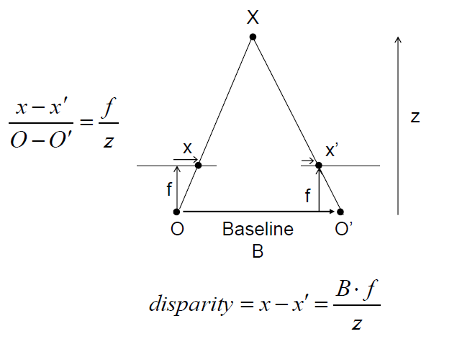
Structured Light General Principle
Goal: recover depth by finding image coordinate x’ that corresponds to x

Slide 15
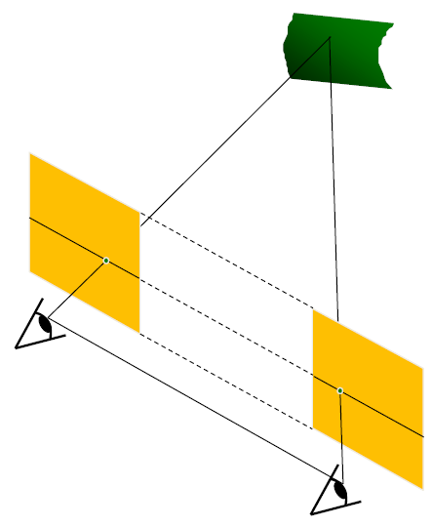
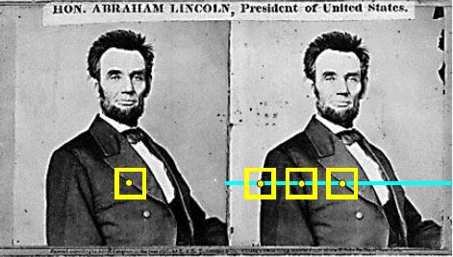
Basic Stereo Matching Algorithm
A speckle in the 1st image is searched for in the 2nd image using Normalised Cross Correlation.
Epipolar lines fall along horizontal Scanlines

Slide 16
Depth from FOCUS
Astigmatic lens

Slide 17
Machine Learning
2.
Body Parts Recognition
Hole Filling
Skeletal Structure Creation

Slide 18
(2.a) Why hole filling..?
Edges of objects
infrared-absorbed surfaces
Highlight Surfaces
Flickering artefacts
Depth Image Based Rendering (DIBR)

Slide 19
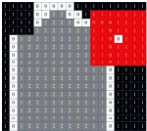
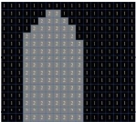
Neighbouring Pixels Interpolating Algorithm
Depth image
Build Hole Matrix
Fix Hole matrix
Fix Depth image
Differential Image matrix
Diff(x,y)
Reference Matrix
R(x,y)
RGB image
Extract
Background B(x,y)

Slide 20
(2.b) Body parts recognition

Slide 21
Mocap data
100,000 skeletons of 15 body types.

Slide 22
forest fire algorithm
randomised decision forest of 3 trees of depth 20

Slide 23
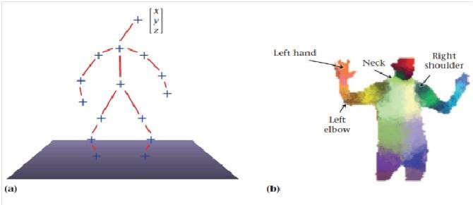
(2.c) skeletal structure creation
15 Main joints in the body are inferred

Slide 24
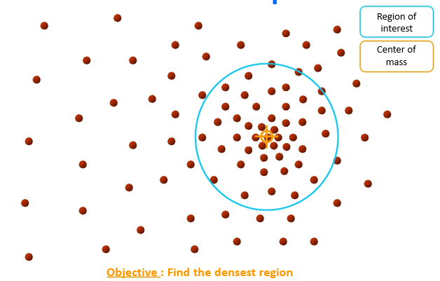
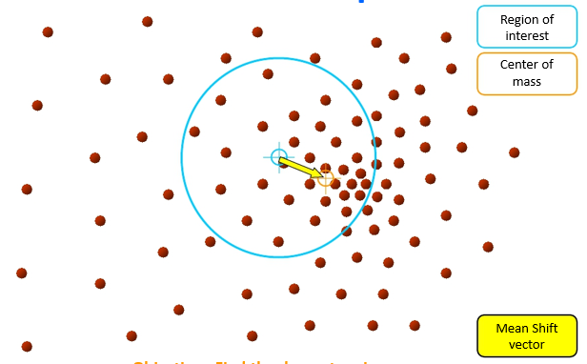
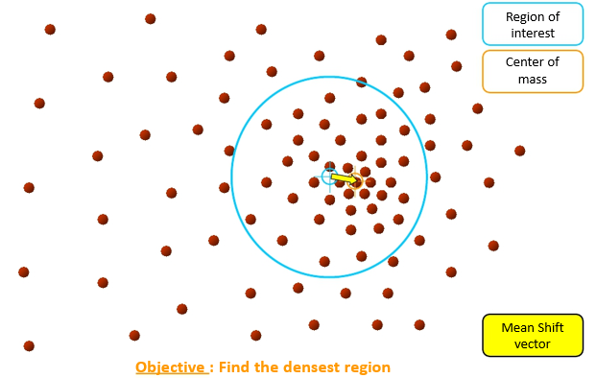
mean shift algorithm

Slide 25
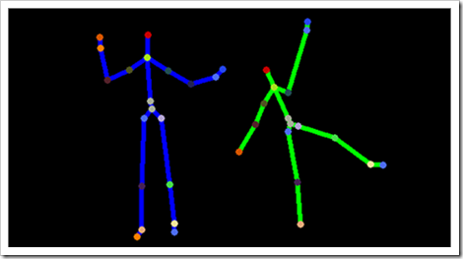

body movement tracking
3.
Likely
Unlikely

Slide 26
Applications = Future scope
Example models, Principles, Micro showcases available till now
Perfect devices featuring this technology not introduced in the market.
In Future, devices using this concept will be flooded in all parts of the market in various fields.

Slide 27
Tele immersive conferencing

Slide 28
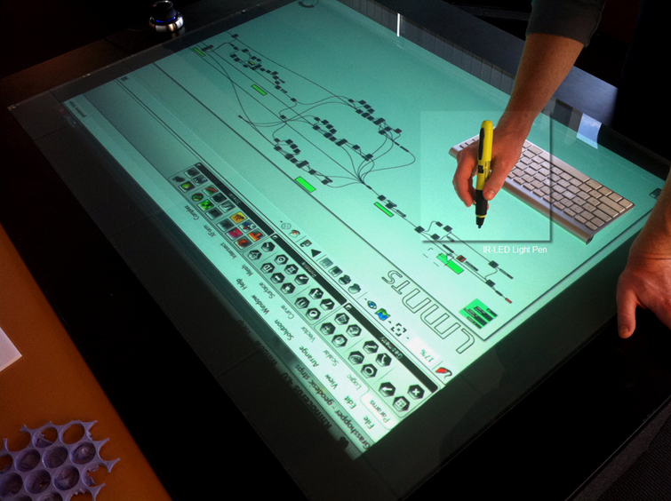
Kinect Multi touch surface

Slide 29
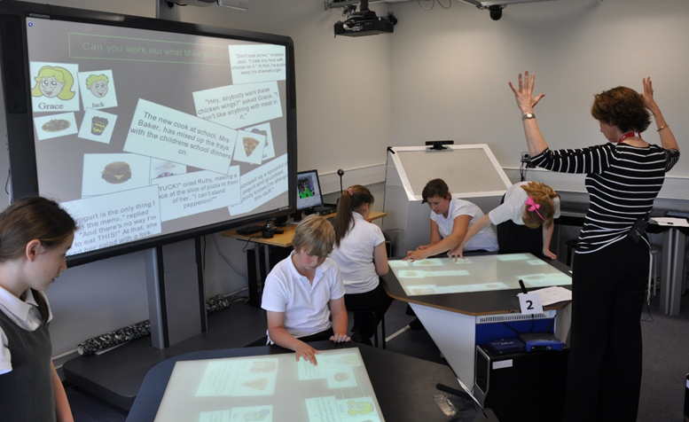
Kinect Education

Slide 30
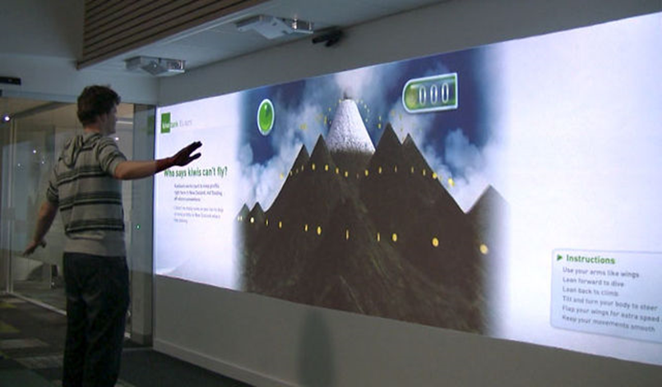
Kinect Interactive Wall

Slide 31
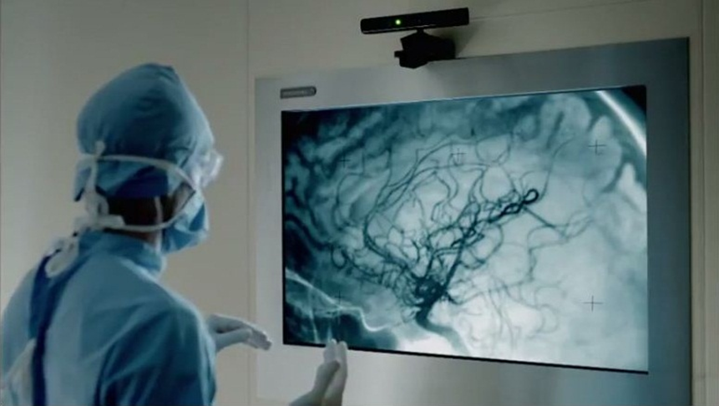
Kinect in hospitals

Slide 32
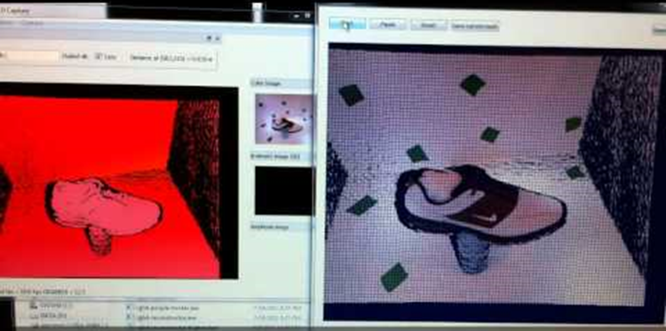
Kinect 3d turntable scanner

Slide 33
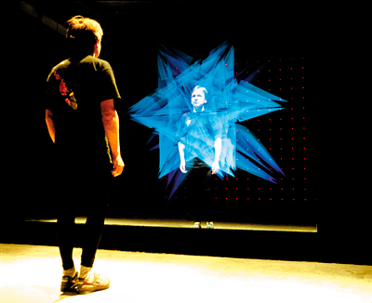
Capture for holography

Slide 34
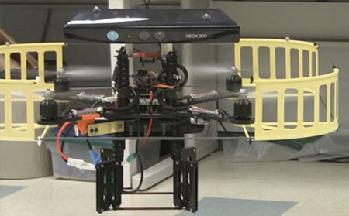
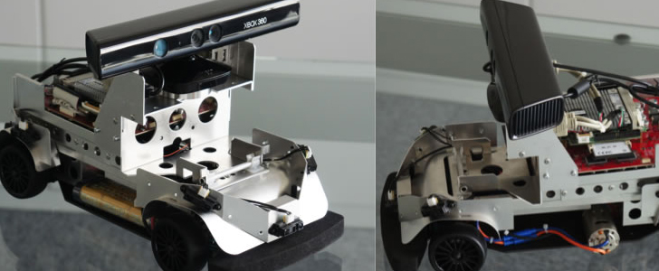
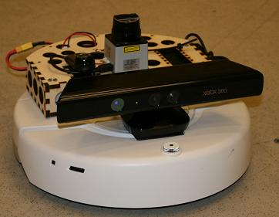
Robot control

Slide 35
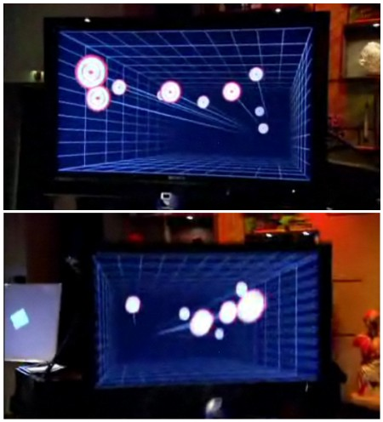
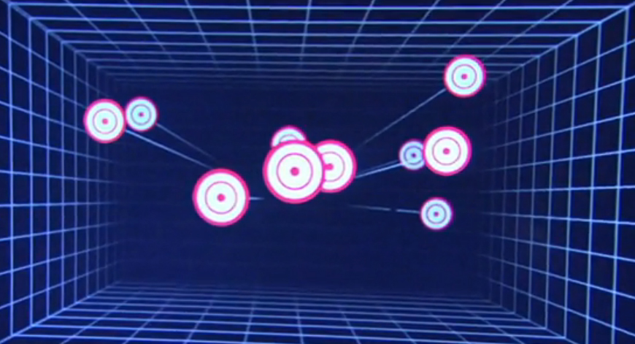
3d gaming using kinect

Slide 36
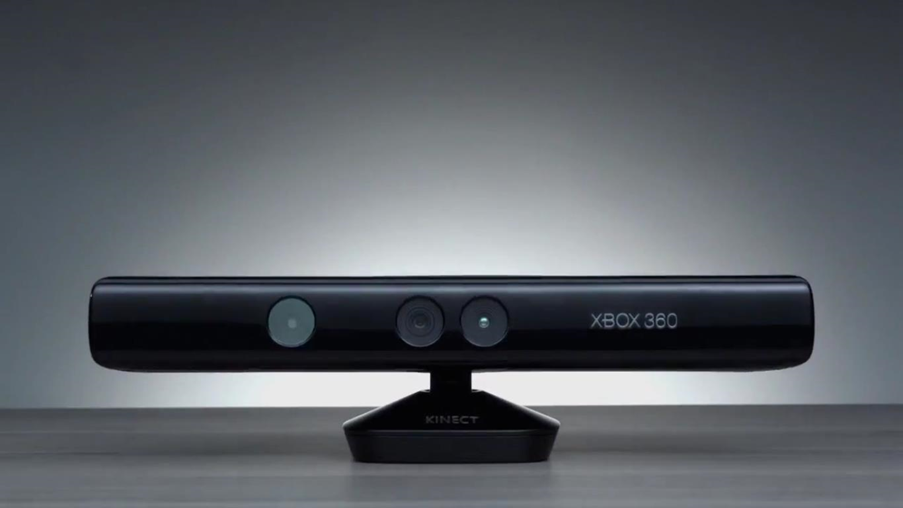
To conclude with...

Slide 37
Thank You !!!

